Slide 1
Awaab’s Law and Fitness for Human Habitation – the same, but different?
Max Gordon and Matthew Timm

Slide 2
What is Awaab’s Law?
Awaab Ishak, a two-year-old boy from Rochdale, died from a respiratory condition caused by exposure to mould in 2020.
"How - in the UK in 2020 - does a two-year-old child die from exposure to mould in his home?" Coroner Joanne Kearsley asked during the inquest.

Slide 3
The Hazards in Social Housing (Prescribed Requirements) (England) Regulations 2025
Awaab’s Law came into force on 27 October 2025.
The regulations require social landlords to fix reported damp, mould and emergency repairs within strict timeframes.

Slide 4
RECAP Fitness for Human Habitation
s 9A LTA 1985 – the implied covenant
s 10 LTA 1985 & HHSRS – prescribed hazards
s 2(1) HA 2004 – definition of “hazard”

Slide 5
s 9A LTA 1985 – the implied covenant
In a lease to which this section applies of a dwelling in England (see section 9B), there is implied a covenant by the lessor that the dwelling—
(a) is fit for human habitation at the time the lease is granted or otherwise
created or, if later, at the beginning of the term of the lease, and
(b) will remain fit for human habitation during the term of the lease.
Notes:
MT

Slide 6
s 10 LTA 1985 – prescribed hazards
In determining whether a house or dwelling is unfit for human habitation, regard shall be had to its condition in respect of the following matters—
and the house or dwelling shall be regarded as unfit for human habitation if, and only if, it is so far defective in one or more of those matters that it is not reasonably suitable for occupation in that condition.
• repair • stability • freedom from damp • internal arrangement • natural lighting • ventilation | • water supply • drainage and sanitary conveniences • facilities for preparation and cooking of food and for the disposal of waste water + any prescribed hazard
Notes:
MG

Slide 7
s 10 LTA 1985 – prescribed hazards
(2) prescribed hazard = any hazard prescribed by The Housing Health and Safety Rating System (England) Regulations 2005 (“HHSRS”)
(3) The definition of “hazard” in section 2(1) of the Housing Act 2004 applies for the purposes of subsection (2) as though the reference to a potential occupier were omitted
Notes:
MG

Slide 8
s 2(1) HA 2004
(1) In this Act –
“category 1 hazard” means a hazard of a prescribed description which falls within a prescribed band as a result of achieving, under a prescribed method for calculating the seriousness of hazards of that description, a numerical score of or above a prescribed amount;
“category 2 hazard” means a hazard of a prescribed description which falls within a prescribed band as a result of achieving, under a prescribed method for calculating the seriousness of hazards of that description, a numerical score below the minimum amount prescribed for a category 1 hazard of that description; and
“hazard” means any risk of harm to the health or safety of an actual or potential occupier of a dwelling or HMO which arises from a deficiency in the dwelling or HMO or in any building or land in the vicinity (whether the deficiency arises as a result of the construction of any building, an absence of maintenance or repair, or otherwise) (s 2(1) Housing Act 2004)
Notes:
MG

Slide 9
HHSRS – prescribed hazards
1. Damp and mould growth 2. Excess cold 3. Excess heat 4. Asbestos and MMF 5. Biocides 6. Carbon monoxide and fuel combustion products. 7. Lead 8. Radiation 9. Uncombusted fuel gas 10. Volatile organic compounds | 11. Crowding and space 12. Entry by intruders 13. Lighting 14. Noise 15. Domestic hygiene, pests and refuse 16. Food safety 17. Personal hygiene, sanitation and drainage 18. Water supply 19. Falls associated with baths etc 20. Falling on level surfaces etc | 21. Falling on stairs etc 22. Falling between levels 23. Electrical hazards 24. Fire 25. Flames, hot surfaces etc 26. Collision and entrapment 27. Explosions 28. Position and operability of amenities etc 29. Structural collapse and falling elements
Notes:
MG

Slide 10
Awaab’s Law
s 10A LTA 1985 – the implied covenant
HHSRS – prescribed hazards
Regulations (prescribed requirements)

Slide 11
Social Housing (Regulation) Act 2023
Inserted section 10A of the Landlord and Tenant Act 1985:
10A Remedying of hazards occurring in dwellings let on relevant social housing leases
(1)This section applies to a lease of a dwelling if—
(a) the dwelling is in England,
(b) the lease is a relevant social housing lease, and
(c) section 9A—
(i) applies to the lease (see section 9B), or
(ii) would apply to the lease if the provision in section 9B(3) did not exist.
Notes:
Social housing under a tenancy
Not under a licence

Slide 12
Social Housing (Regulation) Act 2023
Inserted section 10A of the Landlord and Tenant Act 1985:
(2) There is implied in the lease a covenant by the lessor that the lessor will comply with all prescribed requirements that are applicable to that lease.
(3)The Secretary of State must make regulations which require the lessor under a lease to which this section applies to take action, in relation to prescribed hazards which affect or may affect the leased dwelling, within the period or periods specified in the regulations.

Slide 13
Social Housing (Regulation) Act 2023
Inserted section 10A of the Landlord and Tenant Act 1985:
(4) Regulations under subsection (3) are enforceable against lessors only through actions for breach of the covenant that is implied by subsection (2).
(5) In any proceedings for a breach of the covenant that is implied by subsection (2), it is a defence for the lessor to prove that the lessor used all reasonable endeavours to avoid that breach.
…
Notes:
MG

Slide 14
Some exceptions
s 10A(5) LTA 1985 | Regulation 3(2) - ”relevant hazard” | Regulation 4 - “required work”
It is a defence for the lessor to prove that the lessor used all reasonable endeavours to avoid that breach. | a hazard affecting a social home that: …(c) Is not wholly or mainly attributable to: (i) the lessee’s breach of a convent under the lease, … | Any work: …(b) that the lessor— …(ii) can lawfully undertake if it obtains any necessary consents and in respect of which the lessor has not exhausted all reasonable endeavours to obtain such consents, and (c) that is not work— (i) for which the lessee is liable by virtue of— (aa) the duty of the lessee to use the premises in a tenant-like manner, … (ii) to rebuild or reinstate the dwelling in the case of destruction or damage by fire, storm, flood or other inevitable accident, or (iii) to keep in repair or maintain anything which the lessee is entitled to remove from the dwelling;
Notes:
MG

Slide 15
What hazards? 3 phase implementation
27 October 2025 | 2026 | 2027
All emergency HHSRS hazards (apart from overcrowding) All significant hazards of damp and mould | The below hazards where they present a significant risk of harm: Excess cold/heat Falls associated with baths etc., on level surfaces, on stairs and between levels Structural collapse and explosions Fire and electrical hazards Domestic and personal hygiene and food safety | All remaining HHSRS hazards (apart from overcrowding) where they present a significant risk of harm
Notes:
MG

Slide 16
Key Terms
Competent investigator – a person that, in the reasonable opinion of the lessor, has the skills and experience necessary to determine whether a social home is affected by a significant hazard or emergency hazard.
Emergency hazard – a relevant hazard that poses an imminent and significant risk of harm to the health or safety of an occupier of the social home
Imminent and significant risk of harm – means a risk of harm to the occupier’s health or safety that a reasonable lessor would take steps to make safe within 24 hours.
Significant hazard – a relevant hazard that poses a significant risk of harm to the health or safety of an occupier of the social home;
Significant risk of harm – means a risk of harm to the occupier’s health or safety that a reasonable lessor with the relevant knowledge would take steps to make safe as a matter of urgency (but not within 24 hours);

Slide 17
Step 1: Categorize potential hazard
There are 3 different routes:
Significant hazard
Emergency hazard
Outside scope of Awaab’s Law
Notes:
MG

Slide 18
Emergency hazards-examples
gas leaks,
broken boilers,
total loss of water supply,
electrical hazards,
significant water leaks,
broken external doors or windows where there is a risk to home security,
serious damp and mould or structural defects.

Slide 19
Step 2: Investigate
Investigate any potential significant hazards within 10 working days of becoming aware of them.
Investigation need not be physical. If the tenant requests a physical inspection, further extended period of 10 working days.
Investigate any potential emergency hazards and, if the investigation confirms emergency hazards, undertake relevant safety work within 24 hours of becoming aware of the hazard.
If the investigation concludes that further investigation is required, that further investigation must be completed as soon as reasonably practicable.
Notes:
MG

Slide 20
Regulation 3(1) – significant or emergency hazard?
(a) “significant hazard” means, in relation to a social home, a relevant hazard that poses a significant risk of harm to the health or safety of an occupier of the social home;
(b) “significant risk of harm” means a risk of harm to the occupier’s health or safety that a reasonable lessor with the relevant knowledge would take steps to make safe as a matter of urgency (but not within 24 hours);
(c) “emergency hazard” means, in relation to a social home, a relevant hazard that poses an imminent and significant risk of harm to the health or safety of an occupier of the social home;
(d) “imminent and significant risk of harm” means a risk of harm to the occupier’s health or safety that a reasonable lessor with the relevant knowledge would take steps to make safe within 24 hours.

Slide 21
Step 3: Report
Unless the work has been carried out within 3 working days after investigation, the landlord must provide a report.
To include ‘specified information’:
where the investigation was an emergency, standard or renewed investigation—
whether or not the investigation identified a significant hazard or emergency hazard, and
where such a hazard was identified, what that hazard is;
where further action is required under the Regulations, what that action is and a target timescale for beginning and completing the action;
Or that there is no further action required under these Regulations, and the reasons why;
information about how the lessee may contact the lessor.

Slide 22
Step 4: Works
If the landlord’s investigation (within 10 working days) confirms a significant hazard, it must:
Complete relevant safety works and begin or take steps to begin any further supplementary works to prevent the hazard from reoccurring within 5 workings days of concluding the investigation.
Where further supplementary works are required and it is not possible to begin them within 5 working days, the landlord must start these as soon as reasonably practicable and within 12 weeks of the investigation concluding.
Notes:
MG

Slide 23
Step 4: Works
Reason for not completing works within 5 days: all reasonable endeavors
Consent is required from another party
Subsequent investigation has found no significant or emergency hazard
Safety work completed but further works required – property must be kept safe
Supplemental preventative work to ensure hazard does not recur must be commenced either within 5 working days of the completion of the investigation, or where this is not reasonably practical commenced as soon as reasonably practical and at least within 12 weeks of the completion of the investigation.
This work must then be completed within ‘a reasonable period’.
Tenant must be kept updated

Slide 24
Step 5: Suitable Alternative Accommodation
Significant hazard: if the property cannot be made safe within 5 working days, the landlord must offer suitable alternative accommodation until the significant hazard is fully resolved.
Emergency hazard: if the property cannot be made safe within 24 hours, the landlord must offer suitable alternative accommodation until the safety works are completed.
Temporary accommodation provided at no cost to the tenant’s household - includes any family member who normally resides with the tenant.
Notes:
MG

Slide 25
Step 5: Safety advice to occupiers
Where the landlord believes that occupiers may be in occupation after the initial remediation period, or that the property won’t be wholly unoccupied for the rehousing period, they must give the tenant information as follows:
Where the landlord thinks that action by the occupier can sufficiently mitigate the risk of harm, information about the actions that should be taken until the relevant safety work is completed; or
Where if such actions can’t sufficiently mitigate the risk of harm, information about any action that can reasonably be taken, or avoided, by the occupiers to reduce the risk of harm.

Slide 26
Step 5: Completion of works
The significant/emergency hazard is resolved, all safety works are completed, and the obligation to provide alternative accommodation ends.
Notes:
MG

Slide 27
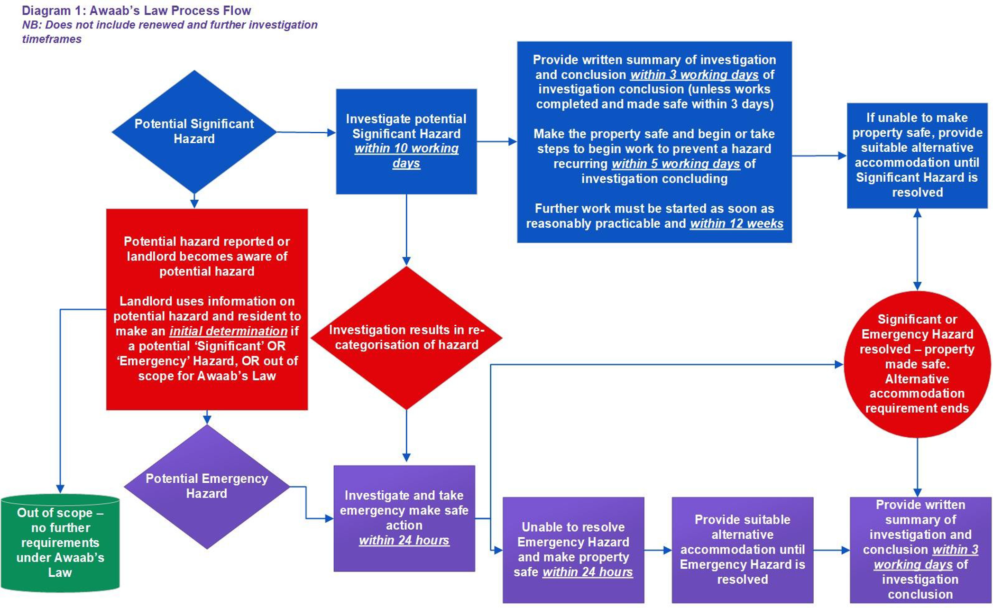
Notes:
Awaab’s Law: Guidance for socia l landlords, 27 October 2025, Diagram 1

Slide 28
Transitional period
If aware of matter before 27 October 2025:
For an emergency investigation, the ‘first report’ will be when reported after 27 October, or from date of knowledge of material change
For a standard investigation, the start point is where a concern is first reported after 27 October, or where the landlord becomes aware of a material change after 27 Oct to an issue it was previously aware of.

Slide 29
Quantum
General principle: (Wallace v Manchester City Council [1998] EWCA Civ 1166)
1) global assessment;
2) notional reduction in rent; or
3) combination of both.
“The object of awarding damages against a landlord for breach of his covenant to repair is not to punish the landlord but, so far as money can, to restore the tenant to the position he would have been in had there been no breach.” (Calabar Properties Ltd v Stitcher [1984] 1 WLR 287)
Notes:
MG
MT – what if tenant not paying rent? Landlord need not pay damages?

Slide 30
Quantum
Fitness for Human Habitation:
100% rent reduction - Dezitter v Hammersmith and Fulham Homes (2023) (Feb 2024, LAG 34)
90% - ‘considerable proportion of rent’ - E v LB Lambeth (Wandsworth CC, 17 April 2024)
Awaab’s Law:
How will the general principle be applied?
Distinction between an emergency hazard and a potential significant hazard?
Overlap between different covenants?
Notes:
MG
MT – what if tenant not paying rent? Landlord need not pay damages?

Slide 31
What has changed?
Timescales
Formality and structure
Reporting

Slide 32
Questions

